Slide 1
Power BI apps on Business Central environment/app telemetry
June 2023 release

Slide 2
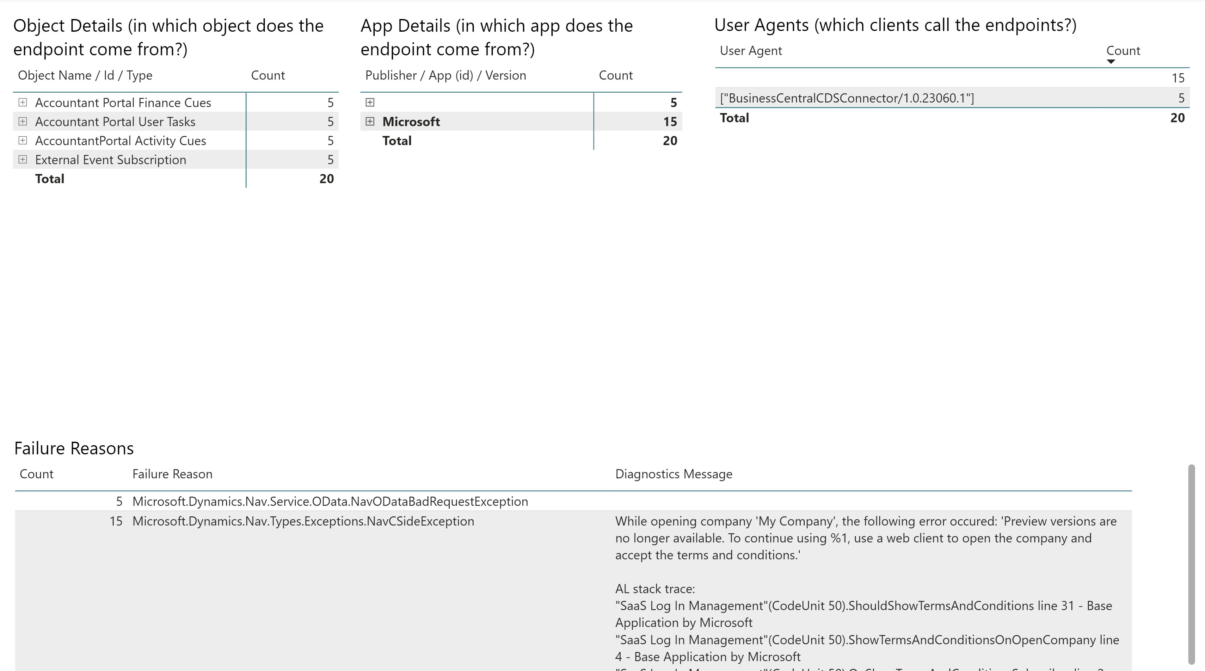
Analyze web service errors (incoming requests)

Slide 3
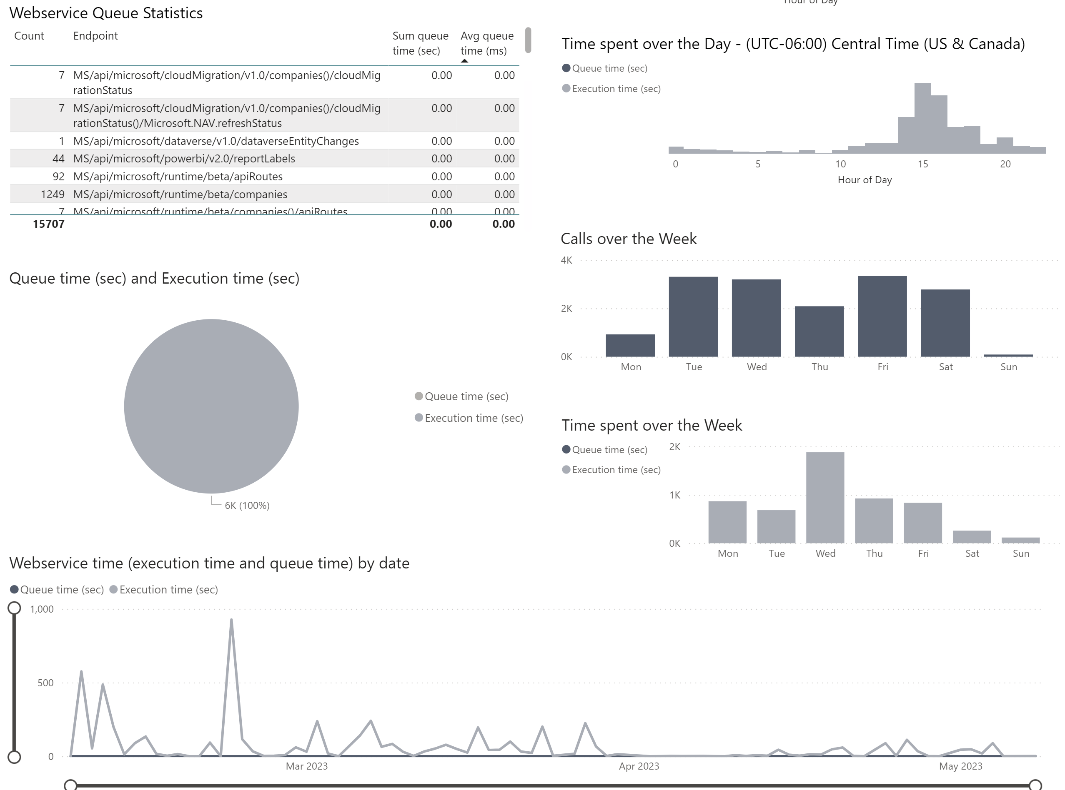
Analyze web service performance (incoming requests)

Slide 4
Analyze web service errors (incoming requests)

Slide 5
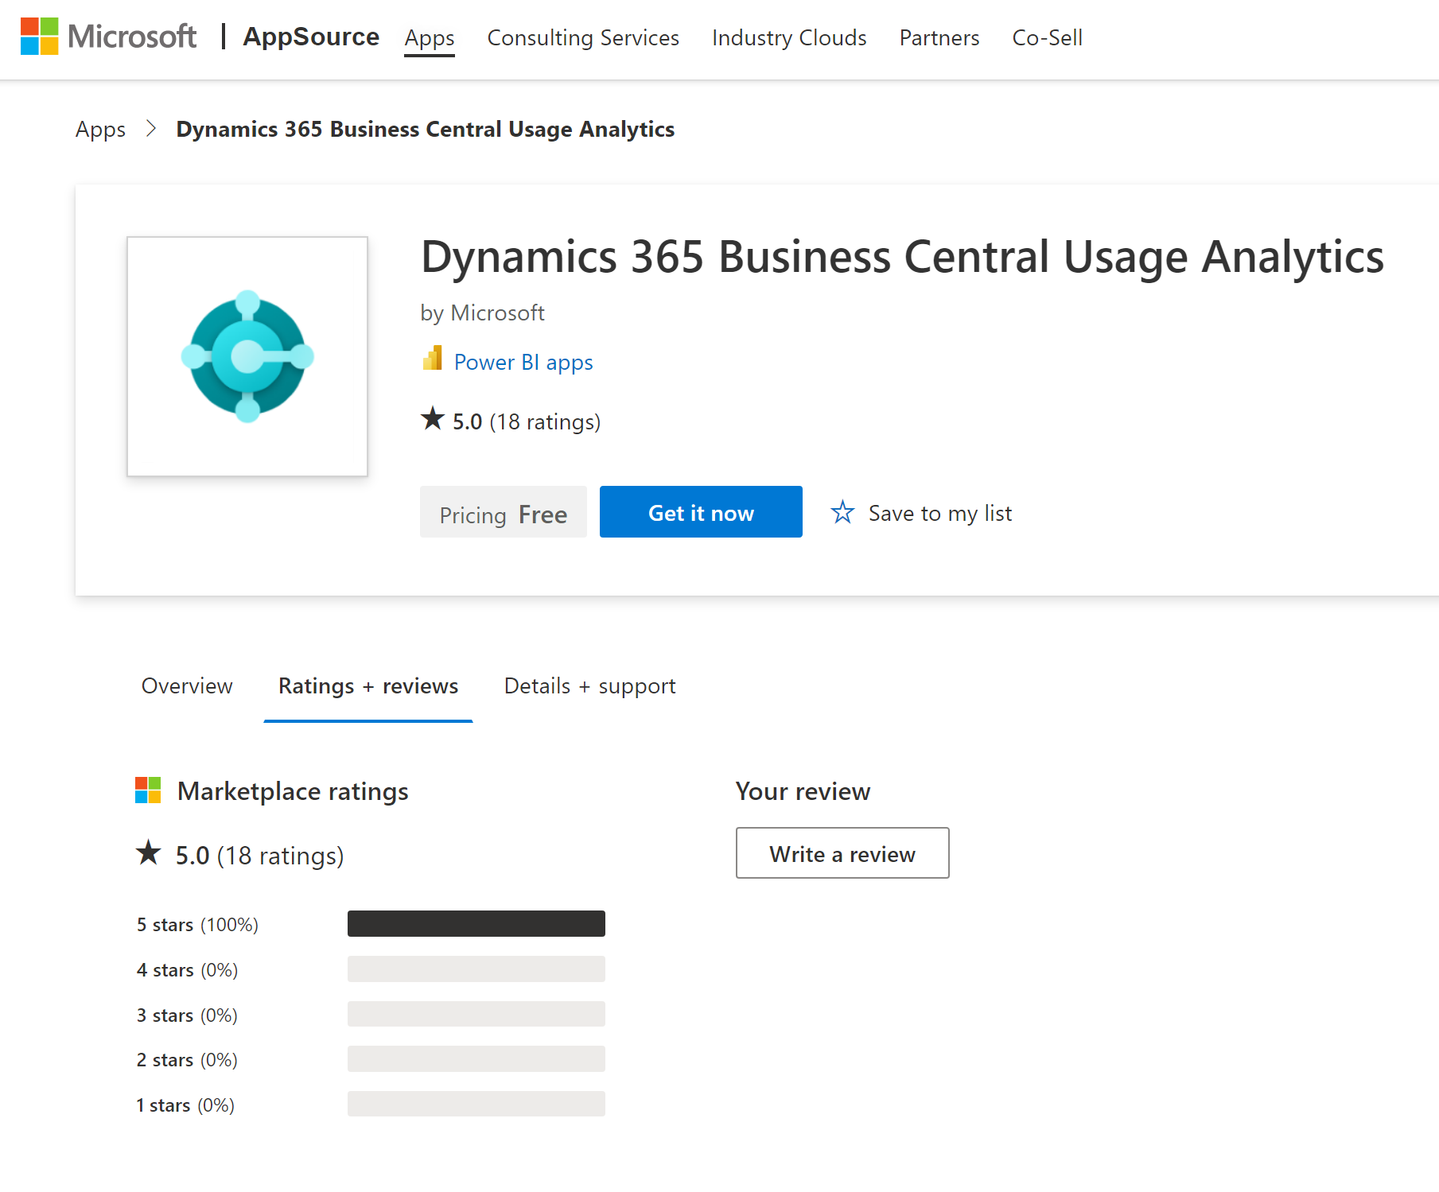
Install/update from Appsource (available now)

Slide 6
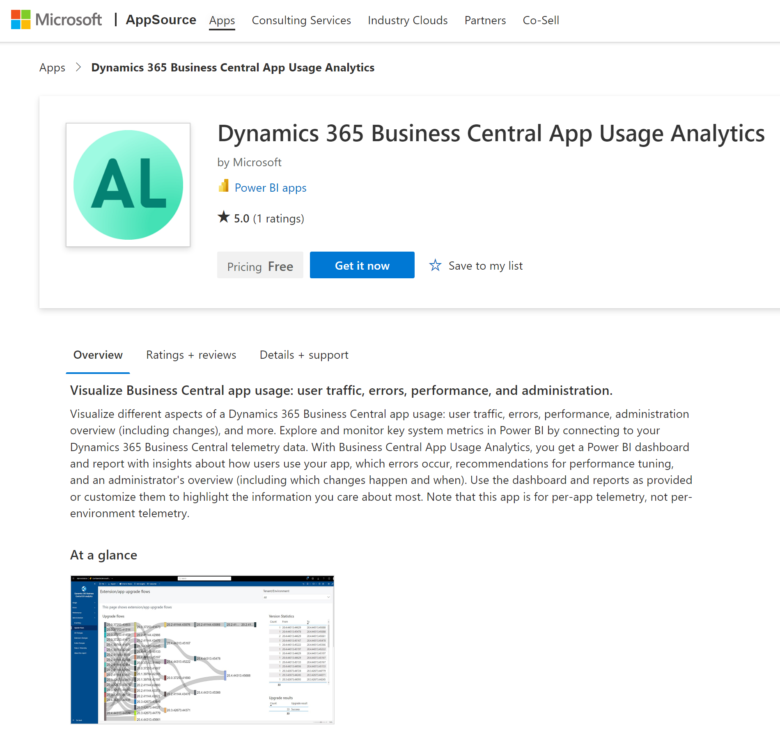
Install/update from Appsource (available now)

